Slide 1



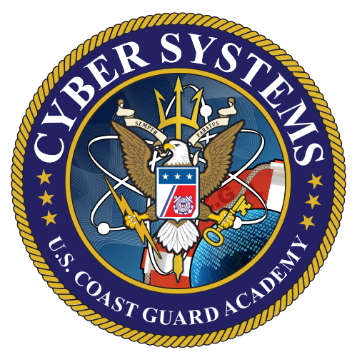
Autonomous UAV Capstone Status Presentation II
1/c Domenico Bulone
1/c Matthew Kim
1/c Gavin McGahey
1/c Cody Meyers
1/c Jacob Schellman
1/c Ryan Von Brock
November 9th, 2021

Slide 2
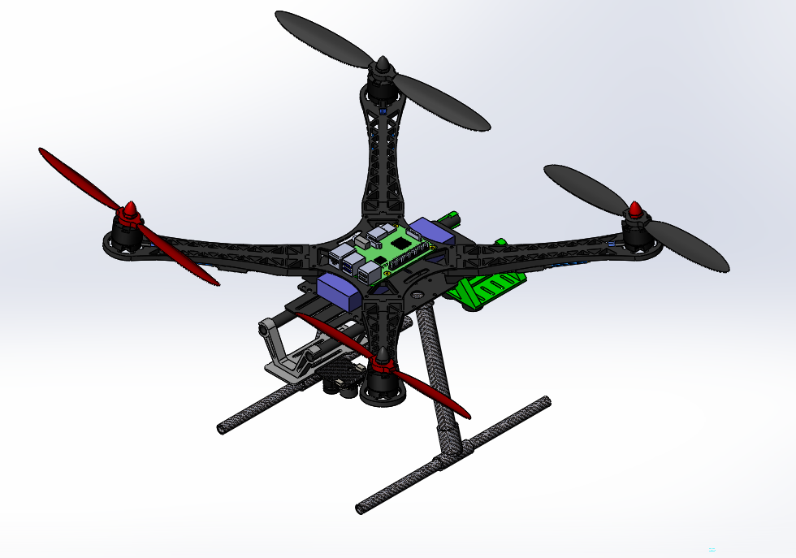
UAV Capstone
Our objective is to design a low cost, open architecture, and cooperative autonomous quadcopter.
Key Performance Parameters:
Stable, Autonomous Flight
Takeoff and Landing from the ASV
Image Processing for Target Recognition
Transporting Small Payloads
Coordinate Objectives with the ASV
Notes:
The objective of this capstone can be summarized as to design a low cost, open architecture, and cooperative autonomous quadcopter. With this objective, there are a few Key Performance Paramaters which, when completed, will allow the UAV to be within the competition requirements of RoboBoat 2022. These parameters are being capable of stable, autonomous flight, being able to take off and land from a moving ASV, being able to transport small payloads, and to coordinate objectives with the ASV. These KPPs, when completed, will show applicability to supplementing Coast Guard missions such as Search and Rescue. To emphasize, this drone could provide an extremely low cost solution to the implementation of unmanned vehicles in CG missions. Currently, SCANEAGLE (3 million) is being utilized by the service at a large cost to the Coast Guard. This solution comes at a miniscule $1000.

Slide 3
Stakeholder Analysis
Leading Advisors:
Professor Hartnett and LT Blanco
Additional Support:
Professor Swaszek and LCDR Veara
Interested Groups:
CG Research Development Center and CG UAS Program

Slide 4
Budget
Future Costs:
No anticipated additions to drone
Dedicated computing resources will add additional costs (on hand versus new acquisition)
Maintenance costs
Major Costs:
S500 Frame: $59
Motors: $100
Raspberry Pi 3B+: $55
Pixhawk 2.4.8: $75
RTK: $675
Approximate Drone Cost: $1025

Slide 5
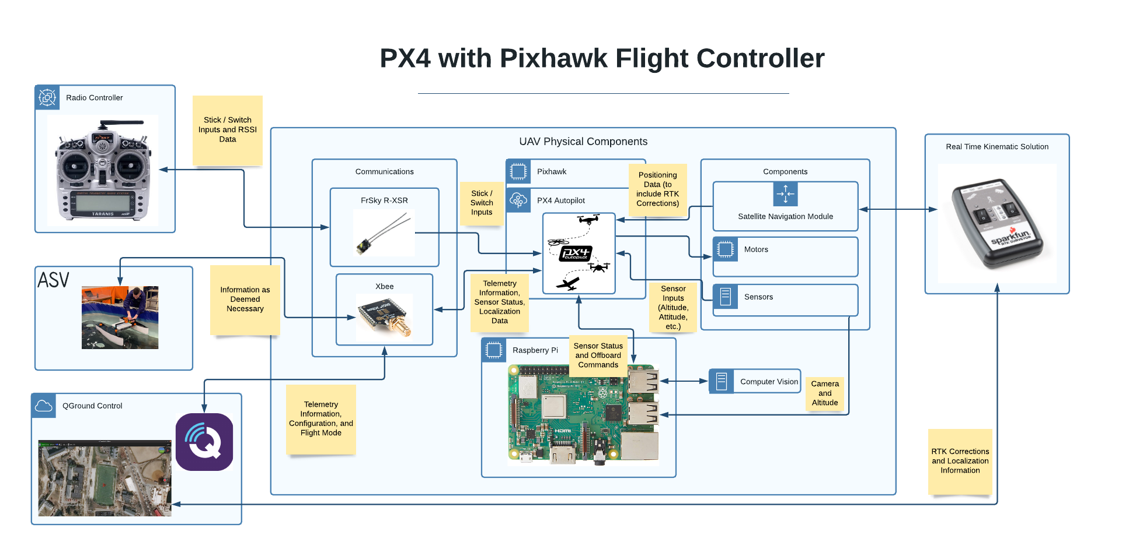
Notes:
1. So now is a good time to take an overview of the UAV and its accompanying systems as we have designed it so far.
2. In front of you now is our preliminary design in very board strokes for the physical – hardware – and software pieces of the puzzle. With respect to time and to best convey the spirit of what we have done, we will classify the above into categories or modules.
2.1 In order to best understand this, it might be prudent to examine the centrally located piece comprised of the components physically present on the UAV, or the UAV Physical Components.
3. In the center of the diagram with many branches outward you can find the Pixhawk and accompanying PX4 flight controller. The Pixhawk autopilot is a physical device optimized for the PX4 flight controller software that accepts a multitude of inputs and outputs in order to enable manual and autonomous flight.
4. Those two pieces in combination are essentially the brains of our drone – they take sensor data and outside communications into account and supply the motors with commands as well as pass information along to accompanying modules.
5. Logically following the brains of the drone would be the communications module. Inside the communications module we have the RC transmitter enabling a transfer of information with a physical controller. In communications we also have the Xbee.
6. The Xbee will ultimately enable communications to a broad number of components in a variety of different ways. By its mesh networking capabilities, communications with the ASV, QGroundControl, and, by extension, our RTK base station are enabled.
7. Following communications, we can examine the raspberry pi and computer vision elements of the drone. Ultimately an entirely onboard autonomous process, the computer vision element will consider camera input and other sensor elements in order to enable autonomous landing and other operations.
8. Finally we can conclude with examining the components. The components are comprised of sensors, motors, and localization or position resources. In conjunction with the Pixhawk, PX4, and QGroundControl, the components enable flight either directly in the case of the motors or indirectly by providing critical telemetry data such as altitude or position.
9. As a whole, while there is certainly a lot to the drone, those three modules – the communications, components, and Pixhawk autopilot, describe the function of the drone in the sense that it – with future development – might accomplish our key performance parameters of stable autonomous flight, landing, and communication with the ASV. There are interior elements to each of these modules – controllers, interior communications, and logic for example – that are not included but certainly exist.

Slide 6
PDR: Physical/Mechanical Requirements
Requirement | Solution
Must not be too heavy (T: Weight < 10 lb) | Small Platform, Weight = 3.05 lb
Equipped with Camera, LIDAR or RTK | Equipped with all three
Capable of transporting small objects | Servo Actuated close/release mechanism
Remain Positively Buoyant in Water Landing (T: > 120 seconds) | Foam outriggers underneath propellers (6 lb of buoyancy)
Electronically Powered (T: < 60 Volts DC) | 11.1 V LiPo Battery

Slide 7
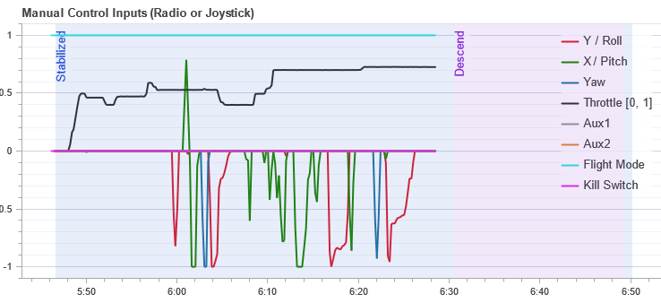
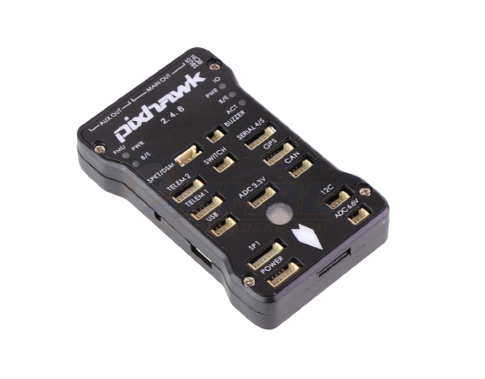
PDR: PX4 with Pixhawk Flight Controller
Free, Open-Source Software
Configurable Failsafe Procedures
Meet Roboboat Safety Guidelines
Satellite Navigation Flight Modes
Autonomous Flight Path Planning
Offboard Flight Mode
Designed for Computer Vision Controlled Flight
Extensive Data Logging
Manual Control
Landing

Slide 8
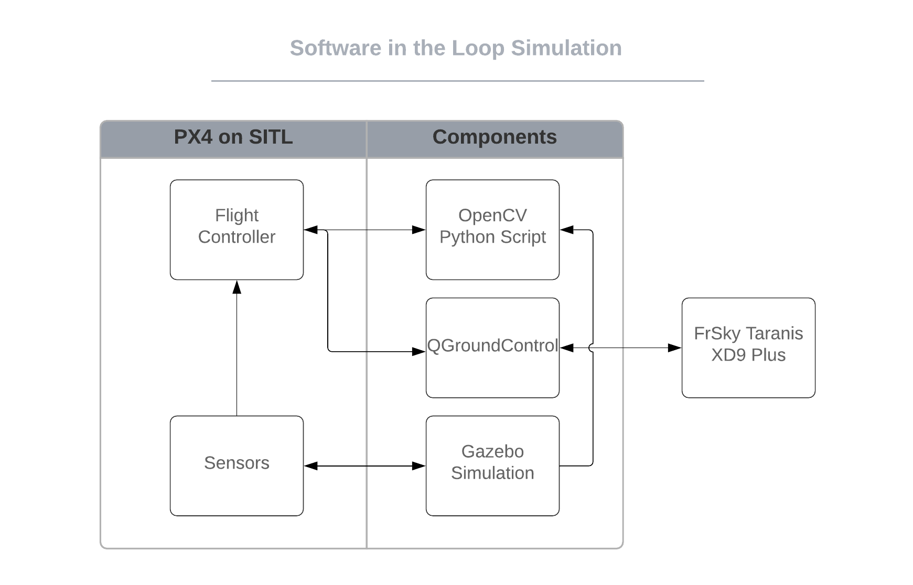
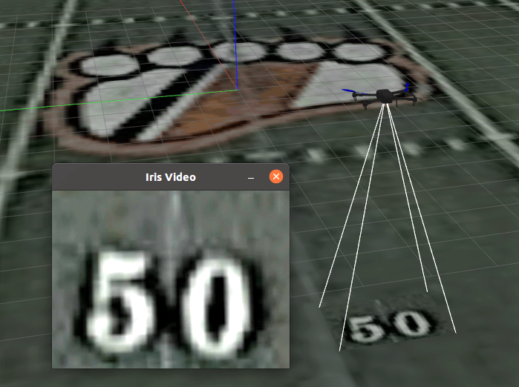
PDR: Software in the Loop Simulation
Gazebo Simulation Environment
An Open-Source, High-Performance Physics Engine
PX4 – Gazebo SITL Simulation
Rapid, Risk-Free Testing with Data Logging

Slide 9
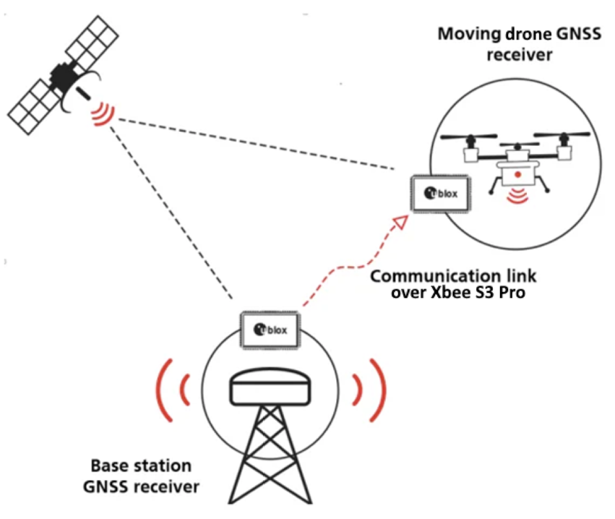
PDR: Satellite Navigation with RTK
Improved accuracy assists ASV
NAVIO2 GPS Receiver:
Existing Alterative: 2.5m accuracy
Sparkfun Real Time Kinematic:
Base Station: 14mm accuracy RTK corrections
Quadcopter GNSS receiver:
Standard 1.5m accuracy
RTK 10mm accuracy
Notes:
- RTK GPS: Real Time Kinematic GPS: takes normal signals from GNSS along with correction stream to achieve positional accuracy
- GNSS (Global Navigation Satellite System): GPS, GLONASS, Galilelo, BeiDou
- RTK receiver takes in RTCM (Radio Technical Commission for Maritime) corrections and calculates our location in real time
- RTCM provides differential corrections information for calculating our location/position
- For our drone, using 2 GPS receivers: base and a rover receiver
- Base receiver: takes measurements from satellites in view & broadcasts them, together with its location, to the rover receiver
- Rover receiver also collects measurements to satellites in view & processes them with the base state data
- Rover then estimates its location relative to the base station
- We will base our accuracy through testing
- with RTK, there is a vertical positioning accuracy also 10mm
- without RTK, there isn't even an option for vertical positioning accuracy

Slide 10
PDR: Computer Vision
Designing flight deck
Utilize image processing algorithm
Communication to controller
Camera feed in Gazebo
Raspberry Pi Setup
Stream to QGroundControl
OpenCV on Pi
Notes:
- Creating a script in opencv, a computer vision python library, is how we will be able to allow for the drone to move based on the detection of a target area.
- Flight deck design that we have been utilizing was from the last group, but we will be creating a new platform based on the design from the previous in order to improve upon issues that exist in the current design.
- In order to detect a platform, we will be utilizing an algorithm for image processing which will allow for the platform to be identified so that the proper movements of the drone can take place. Currently, we have achieved shape detection through use of contours. This can work, but it may be too difficult a route in order to achieve our end goals. Research is ongoing into which algorithm we will be using to create our script.
- Inputs from the code from opencv (desired direction the drone needs to move based on detection of platform), translated over a mavlink command to output yaw, pitch, and roll of drone via serial connection to controller to send and receive the data. Research is ongoing into methods by which we can most efficiently establish this communication.
- We have been able to get camera feed in our testing environment which allows for us to change multiple variables such as brightness, cloud/simulated weather, shadows, etc. Additionally we can upload our own image of a landing pad, this will allow us to complete further tests in the testing environment to mitigate issues in our methods before completing tests during flight days.

Slide 11
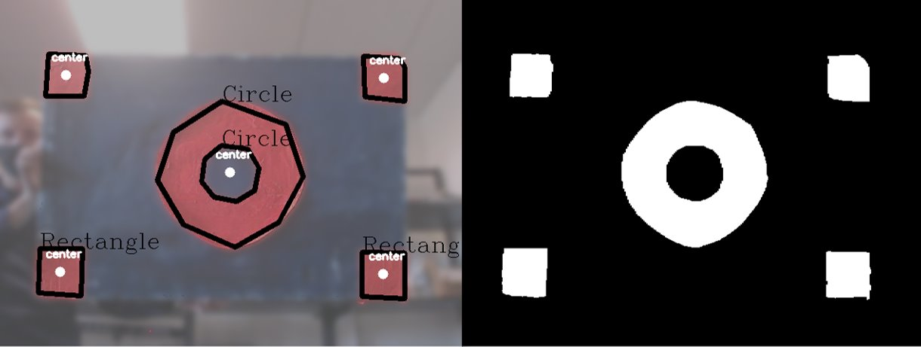
PDR: Computer Vision Testing
In-Lab Tests
Detecting red rectangles and circles, finds centroids
Frames vs. Number of Shapes
Notes:
-We created the algorithm to work perfectly within the lab environment and lighting
-Centroid use to find directions. We are going to compare the centroid to the center of the screen and then use that difference to tell the drone where to go and use the controller
-72.6%

Slide 12
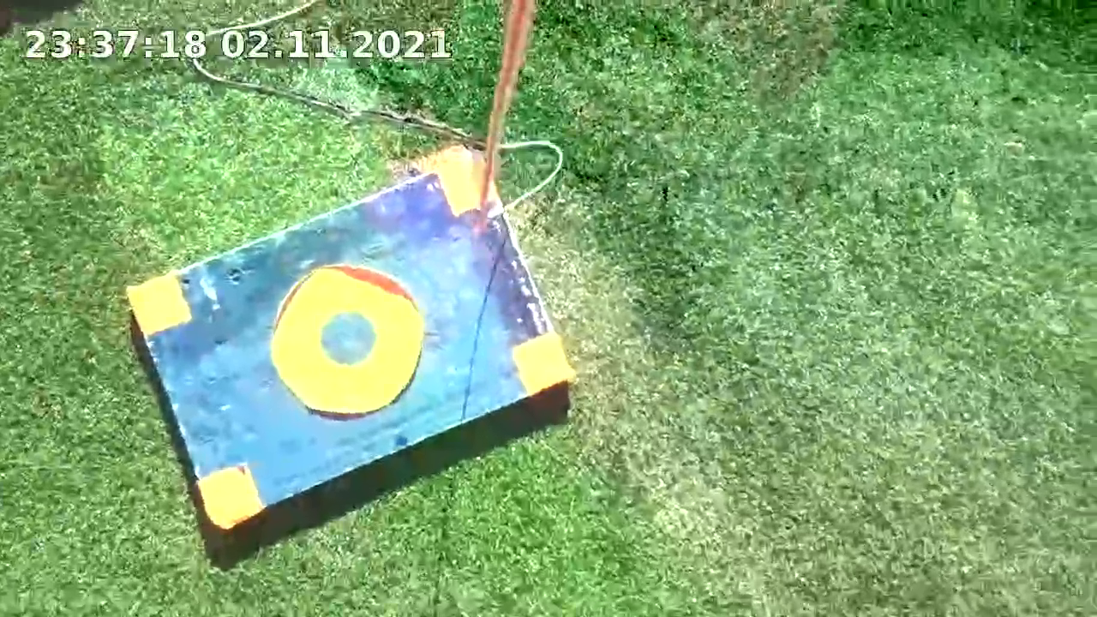
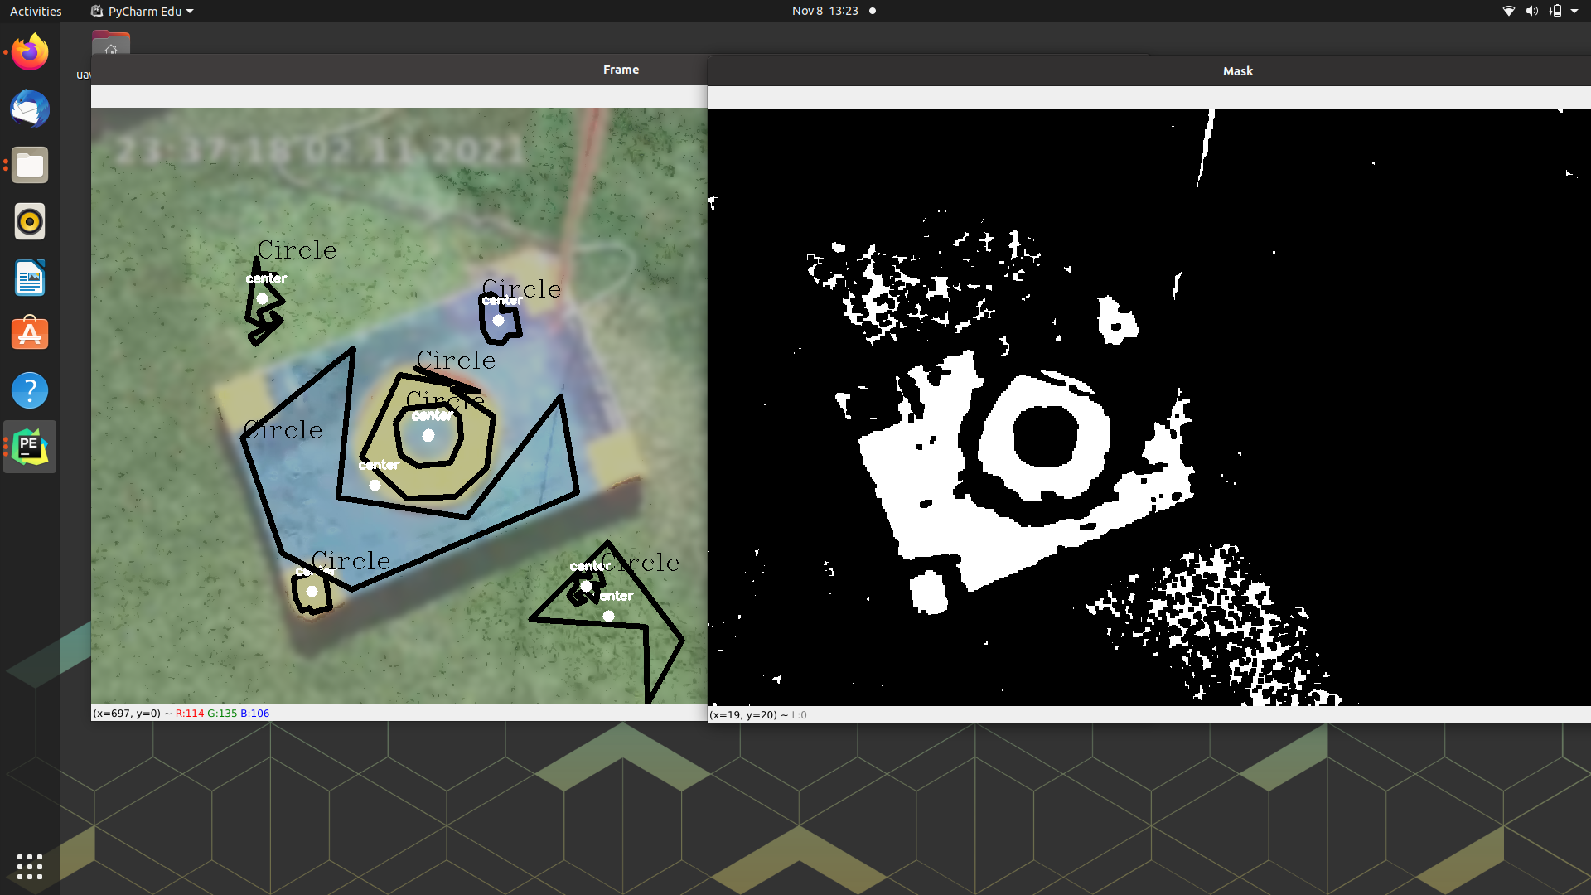
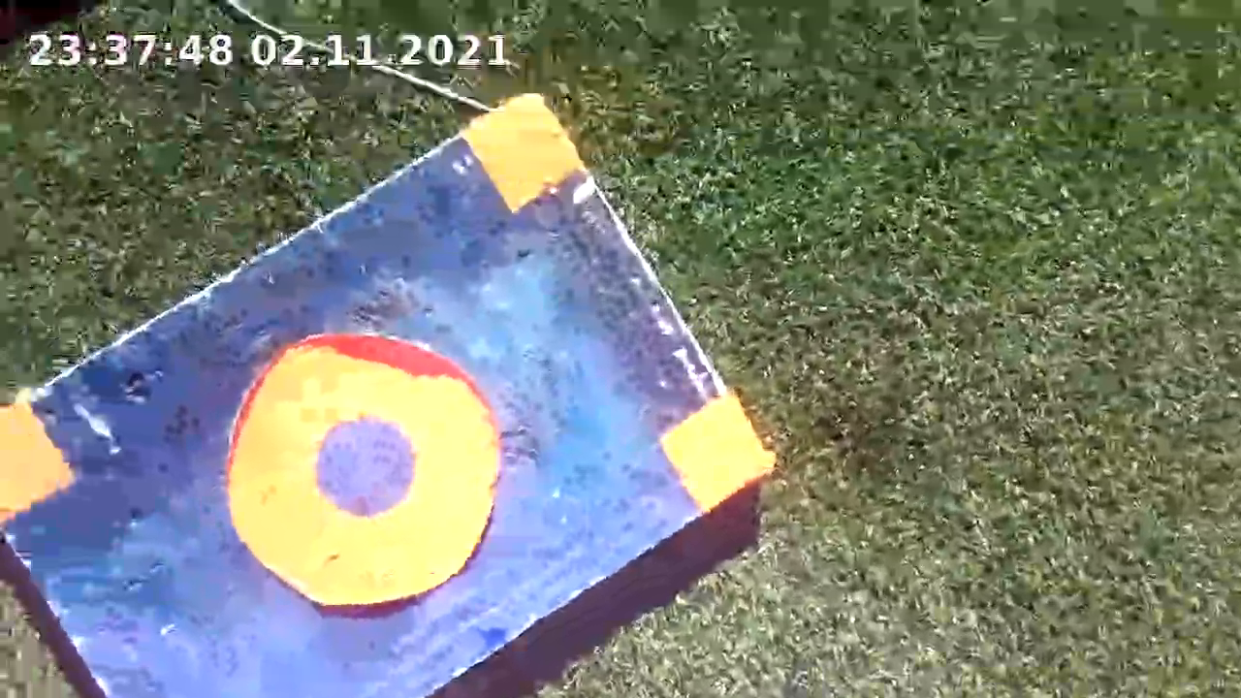
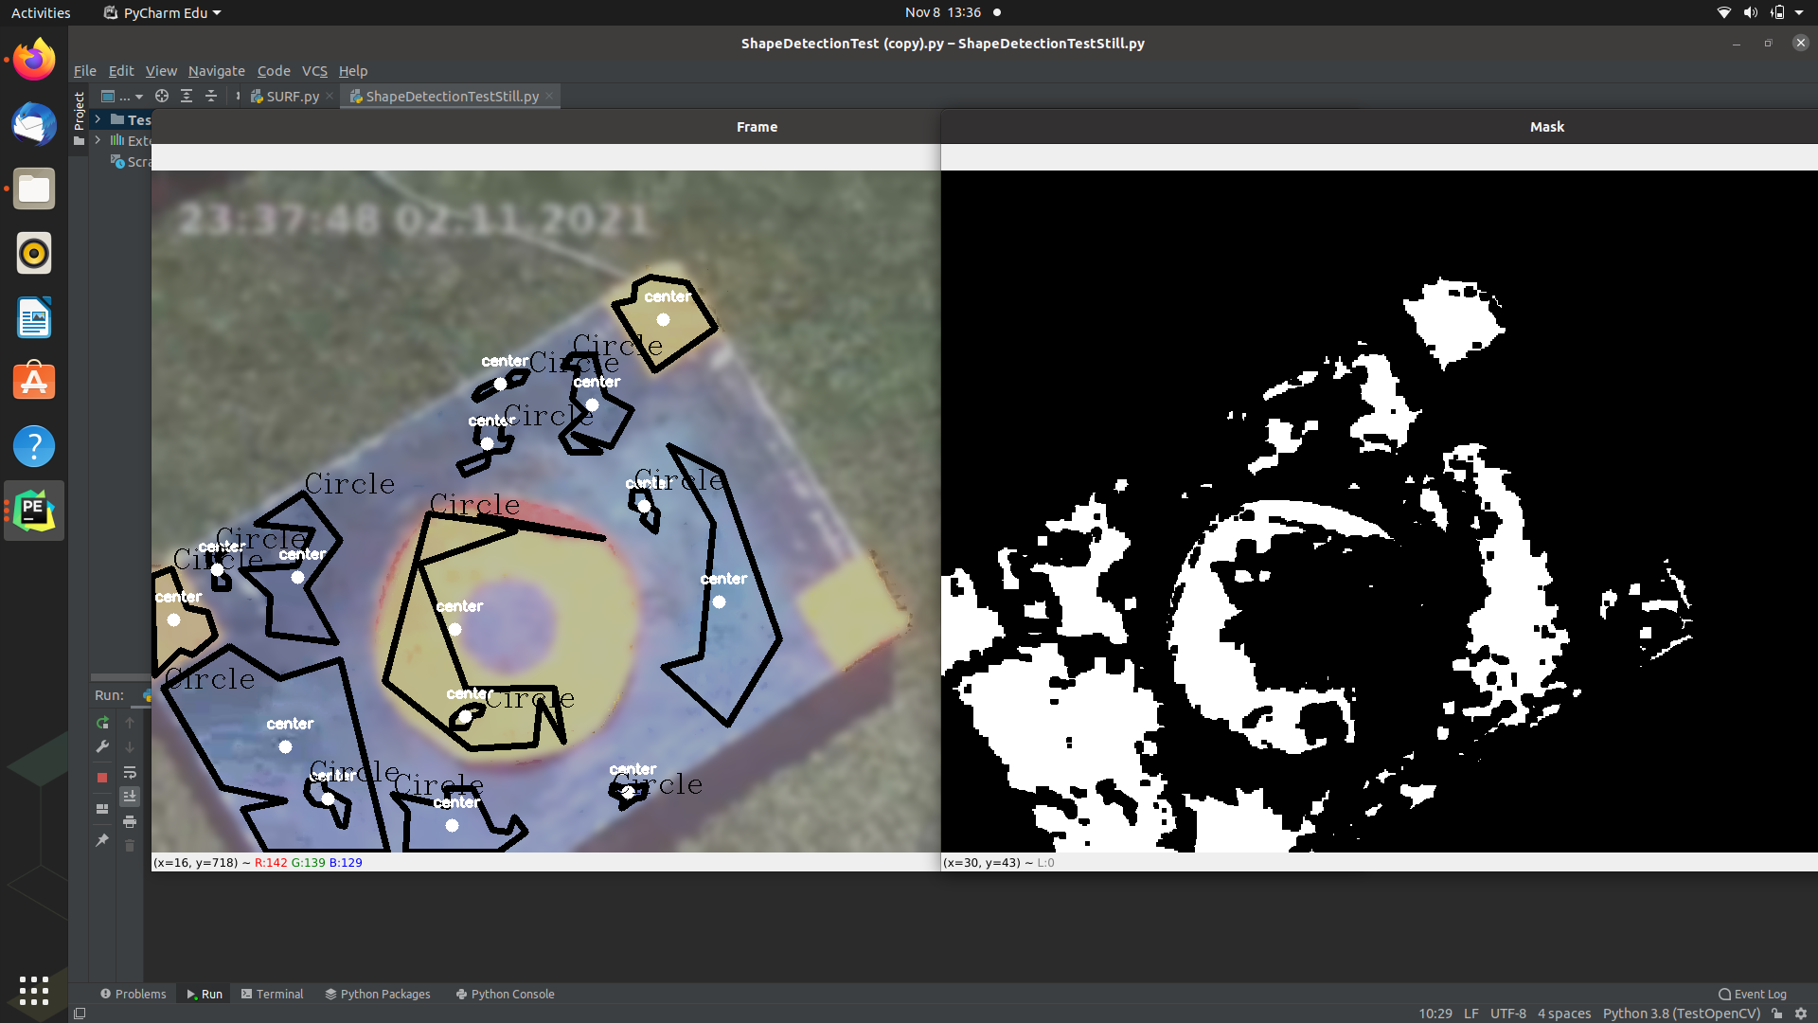
PDR: Computer Vision Testing
Field tests not as successful
Refine color values
Upgrade camera
Notes:
- Were not as successful as we would have hoped as you can see. The mask however did do a fairly good job at detecting the outside of the shapes which has led us to believe that the issue is with our color values. The video quality is also poor and we had issues with saving video a file format which could also be it.
-We were unable to do quantitative testing outside due to unforeseen issues with saving the video and file formatting.
-We want to refine color values based off of weather
-We want to make tape less reflective
-We want to try again after making these changes and fixing the simple file format
-If those changes don't work, then we do have the possibility of switching to a different a higher resolution camera but that brings it's own slew of challenges should we decide to go that route.

Slide 13

Kickoff Meeting
KPIs Defined
Jan 28 - Mar 31
Jul 13 - Sep 30
Feb 17 - Mar 31
Oct 21 - Dec 25
Jan 2 - Mar 31
Jun 4 - Jul 11
Feb 23 - Apr 7
Apr 2 - Apr 28
Apr 2 - Jun 10
Jul 7 - Sep 14
Aug 3 - Oct 28
Sep 1 - Oct 21
Apr 2 - Jun 2
Feb 2 - Apr 7
Jun 5 - Aug 5
Apr 1 - Sep 1
62.8 days
44.8 days
56.4 days
43.5 days
30.4 days
18.3 days
43.5 days
62.2 days
46.9 days
2021/Mar
2021/Jul
2021/Sep
2021/Dec
26 days
46 days
50 days
50 days
7.1 wks
Dec 20
Aug 10
Oct 19
May 19
Oct 18
Dec 21
Jan 16
Mar 31
Mar 31
Jul 28
2021
Apr 1
Jun 7
75%
75%
75%
75%
Today
2021
Research Progression
Status Presentation 1
Status Presentation 2
Semester Presentation
Final Presentation
2021
2022
August — September
October
November — December
Spring Semester
Drone Assembly
Drone Flotation
Payload Delivery
Optimize Design
Physical Platform
Test Manual Flight
Test Video In-Flight
Test Autonomous Flight
Further Flight Testing
Flight Controller and Autopilot Decision
Controller Tuning
SITL Computer Vision Controlled Flight Test
Flight Controller
Controller Tuning
Refine Controller Tuning
GPS/RTK Integration
GPS/RTK
GPS Testing
RTK Testing
Initial Research and Script Development
Camera Mounted, and Script Running on Drone
Develop Preliminary Script for SITL Testing
Improve Script Reliability and Efficiency
Computer Vision
Notes:
1. So, to conclude our presentation, we wanted to mark where we stood in our Capstone Development process as a whole.
2. Examining those four distinct workflows – our physical platform or the drone itself, the flight controller, localization resources including RTK, and computer vision – we have made progress at varying rates and are at stages of varying completeness.
3. With respect to the physical drone, we do indeed have a completed drone capable, at this time, of stable manual flight and landing. Requirements such as buoyancy of the drone as well as payload delivery are either nearly complete or very near in our future. Small improvements are expected to be made, but soon we will mark a transition from enabling flight – be that autonomous or manual flight – to optimizing our design in stability, weight, and other physical factors.
4. Our flight controller workflow works in conjunction with many of the others. At this point, our flight controller supports our existing frameworks. However, in the future, we foresee that PX4 will more and more gain responsibility in enabling autonomous flight and landing.
5. Our localization or positioning workflow is by far the shortest workflow and is rapidly nearing its end. As development continues, RTK will become a critical component in ensuring that we have the resources we need to meet our requirements – especially with respect to autonomous landing and landing on the ASV where centimeters will certainly matter.
6. Finally, our computer vision workflow. Our computer vision workflow is a continuing development and will see progress well into the spring semester. While tasks have been accomplished, the state of computer vision when applied to field tests is ultimately not acceptable at this point. Improvements to the script reliability are key and, in order to best enable us to make those improvements, software in the loop testing should be implemented as soon as possible.
7. With each of these things in mind, we would like to now open to any questions. Thank you!

Slide 14
Questions?

Slide 15
RTK order,
Image processing vs RTK
Specifications slide (overarching; Objective vs Thresh)
Scaneagle vs ours comparison. Different missions, different capabilities. Maybe units with CH drones.
Overview at the beginning.
Homography matrix
Wrapping attitude, match heading vecoters, test controlling velocities*

Slide 16
Future Development
Date
Date
2022
SITL simulation testing computer-vision controlled landing.
RTK and standard GPS accuracy test.
Final Goal
Test Flight II
Date
Date
Autonomously fly predetermined paths. Utilize GPS with RTK corrections.
Multiple input multiple output controller transforming computer-vision positions to drone movements.
Adding robustness to image detection method.

Slide 17
Entrance Criteria
Have you finalized your requirements documentation? (i.e. Have you made edits after instructor feedback?, Have you consulted with stakeholders on final approval?)
Have you reviewed comments/questions from Status Presentation # 1? Are you able to provide answers if the same question arises again?
Have you developed a budget? Are you prepared to present updates to your budgets?
Have you finalized/updated/maintained your list of stakeholders? Have you proactively engaged with stakeholders to ensure project is on track?

Slide 18
Exit Criteria
Does your preliminary design clearly convey how your system will close your identified capability gap?
Does your preliminary design convey how your system will accomplish your operational requirements?
Does your preliminary design indicate which configuration items will accomplish which functional requirements?
Is your design reasonable with respect to project cost, schedule, and performance?
Is your design properly documented and researched?
How well does your design define system inputs and outputs?

Slide 19
Additional considerations
Communicate clearly how your design decisions time to your requirements - Functional allocation to sub-system/CI’s.
Identify diagrams to include network interfaces (Internal and External)
Demonstrate, through information provided on the slides, how well the systems, subsystems and CI requirements are being scheduled and managed.
Identify all subsystems, components, Cis and their relationships, including all connections/interfaces between them. You can do this using graphics, pictures, or text.
Identify/discuss any new trade studies or analyses used to make choices and resolve conflicts during the Design phase
Identify/discuss how the functional and non-functional requirements defined in the FRD are allocated to the various subsystems, components, and CIs
Discuss any requirements changes since the System Definition Review:
Security critical requirements;
Quality requirements (including reliability, availability, and maintainability);
Requirements supporting test and analysis (i.e., log files);
Safety critical requirements;
Environmental requirements for hardware components in the system, including shock, vibration, EMC, EMI, or atmospheric conditions requirements
Identify/discuss any events and general test build plans and deadlines
Identify/discuss test processes, including certification test requirements

